Slide 1

Personal Bank Ledgers & Statements
A student's guide to understanding, reading, and using your bank records to build a confident financial future.

Slide 2
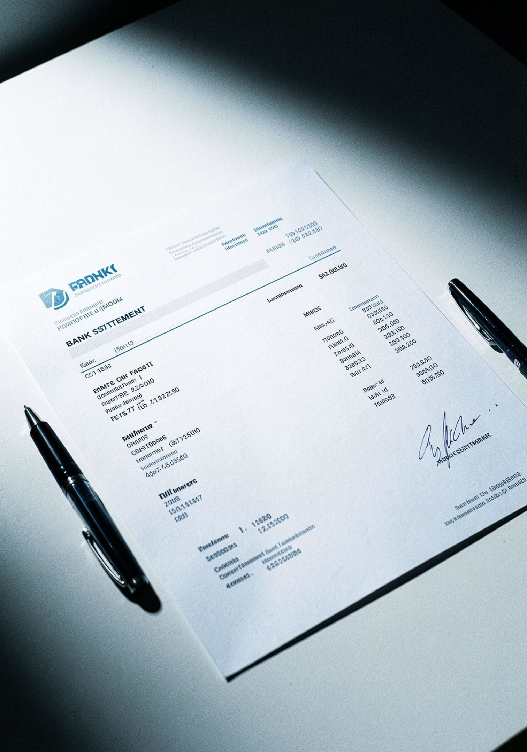
What is a Bank Statement?
Official Financial Record
A complete log of every transaction that occurred in your account — issued directly by your bank.
Shows the Full Picture
Deposits, withdrawals, fees, and your running account balance — all in one place.
Delivered Monthly
Banks typically provide a new statement every 30 days, either by mail or through your online account portal.

Slide 3
Key Components of a Bank Statement
Account Number & Period
Opening & Closing Balance
Transaction List
Your unique account ID and the exact date range the statement covers — usually one calendar month.
How much money was in your account at the start of the month, and how much remains at the end.
A line-by-line record of every deposit and withdrawal — the heart of your statement.

Slide 4



Understanding Ledger Entries
Debit — Money Going Out
Withdrawals, purchases, ATM cash, and fees. Debits decrease your balance.
Credit — Money Coming In
Paychecks, refunds, and interest earned. Credits increase your balance.
Every Entry Has Three Parts
Date, description of the transaction, and the dollar amount — always logged in order.

Slide 5
Reading Transaction Details
Every row in your statement tells a story. Here's how to decode it:
Date | Description | Amount | Balance
Oct 1 | Opening Balance | — | $1,200.00
Oct 3 | Paycheck Deposit | +$850.00 | $2,050.00
Oct 5 | Grocery Store | –$62.40 | $1,987.60
Oct 9 | Netflix Subscription | –$15.99 | $1,971.61
Oct 14 | ATM Withdrawal | –$40.00 | $1,931.61
Oct 31 | Closing Balance | — | $1,931.61

Slide 6
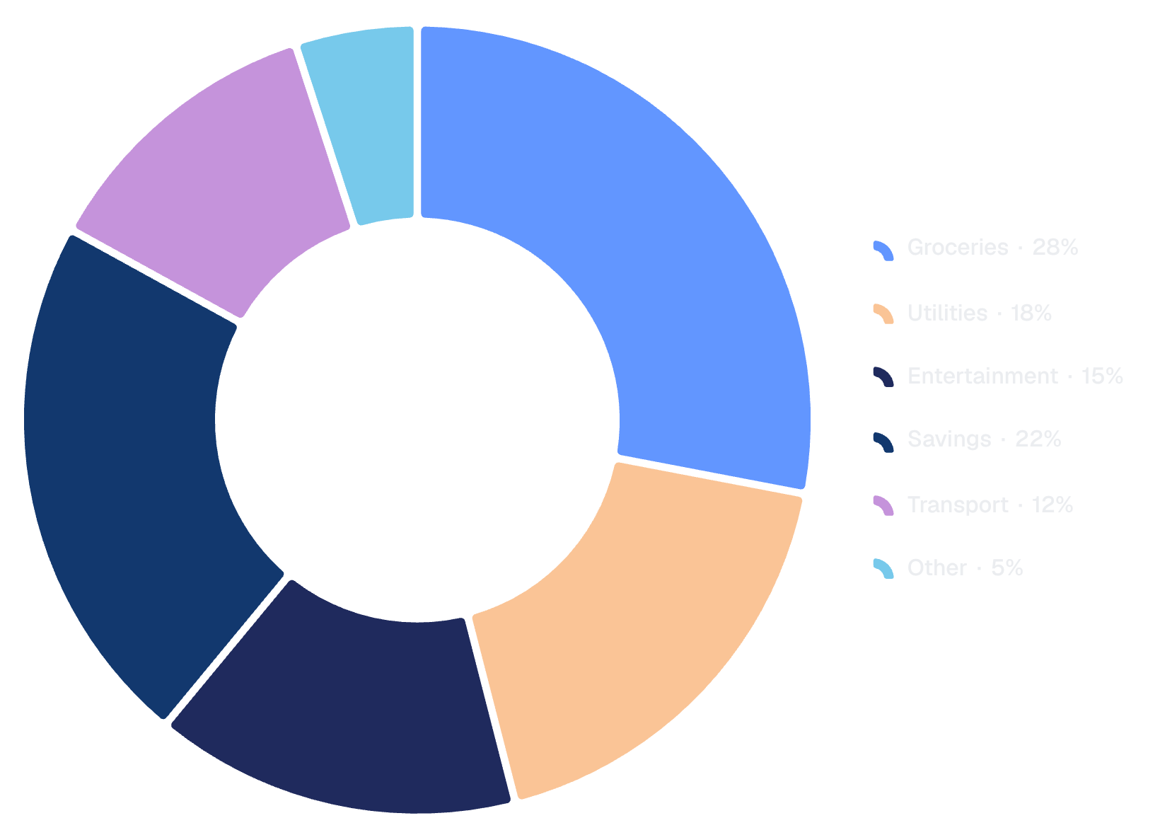

Tracking Income & Expenses
Why Categorize?
Grouping transactions into categories reveals where your money actually goes — often surprising!
Groceries & utilities — essential, predictable costs
Entertainment — easy to overspend without noticing
Savings — treat it like a non-negotiable expense
Use historical spending data from your statements to set realistic monthly budgets for each category.

Slide 7




Why Keep a Personal Ledger?
Catch Errors Early
Spot unauthorized transactions or bank mistakes before they become bigger problems.
Track Financial Goals
See your savings grow over time and stay motivated toward milestones like a car or trip.
Accurate Records
Keep clean documentation for tax season, financial aid applications, or rental agreements.

Slide 8
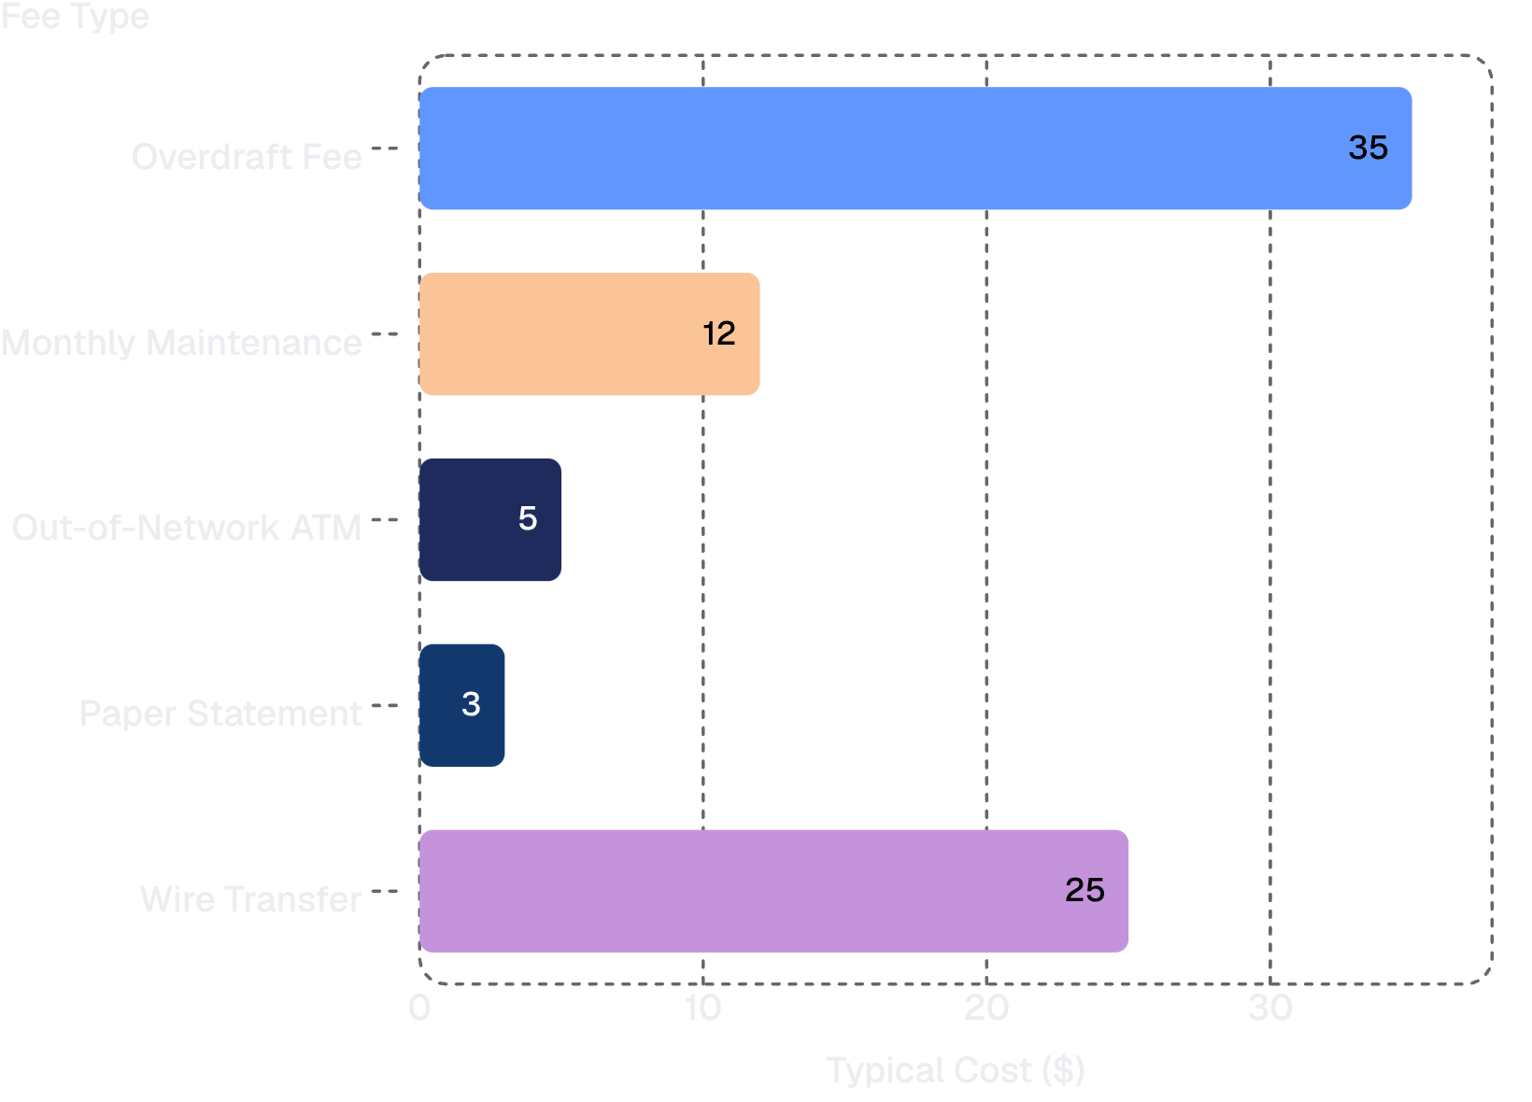
Common Bank Fees to Watch
Don't Let Fees Drain You
Bank fees can quietly eat into your balance month after month. Know what to watch for:
Overdraft fees ($35 avg.) — triggered when your balance goes negative
Monthly maintenance — often waived with a minimum balance or direct deposit
ATM fees — use your bank's network or choose a fee-free account
Reading your statement regularly is the best way to catch these charges fast.

Slide 9



Tips for Smart Banking
Review Statements Monthly
Keep Your Receipts
Set Up Account Alerts
Set a recurring reminder each month to open your statement and scan every transaction for accuracy.
Match physical or digital receipts against your bank statement — discrepancies can signal fraud or errors.
Most banks let you set automatic notifications for large withdrawals, low balances, or unusual activity — turn them on!

Slide 10

Start Your Financial Journey Today
Knowledge is your greatest financial tool.
Understand
Track
Read your bank statements and ledger entries with confidence — you now know exactly what every line means.
Categorize your spending, spot patterns, and hold yourself accountable every single month.
Build
Use your insights to budget wisely, avoid fees, and grow your savings toward the future you want.
Financial literacy starts with one statement. Open yours today. 💰

